Slide 1
Full Monte Cost and Schedule Risk Analysis
for Microsoft Project
from Barbecana

Slide 2
Full Monte Cost and Schedule Risk Analysis
Full featured Monte Carlo Risk Analysis
For Microsoft Project 2007 and 2010
Schedule Risk Analysis
Cost Risk Analysis
Sensitivity Analysis
Schedule Quality Checks
Compatible with Risk+ data
High Performance

Slide 3
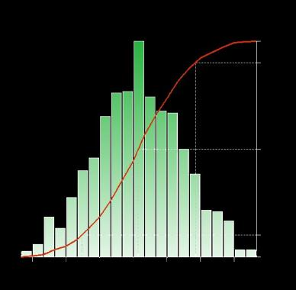
Schedule Risk Analysis
3 Point Duration Estimates
Probability Distributions
Probabilistic and Conditional Branching
Correlation between Activities
Criticality Index
Probability
Confidence
Time

Slide 4
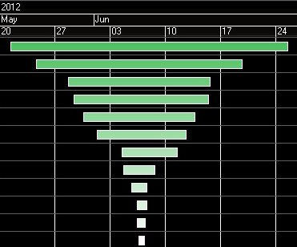
Sensitivity Analysis
Allows you to identify the tasks creating the most uncertainty in project or milestone outcome
Sensitivity Index
Tornado Chart
Tornado Sensitivity Chart

Slide 5
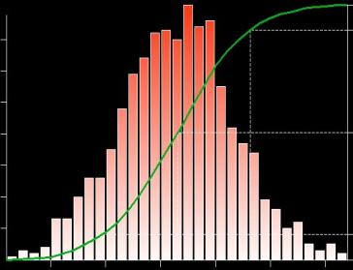
Cost Analysis
Calculates Task and Project cost
Takes into account Per Use Cost, Actual Costs, and Rates
Uses Escalated Costs for late running tasks
Probability
Confidence
Cost

Slide 6
Probabilistic and Conditional Branching
Probabilistic Branching
Define the probability of various paths through the project logic being executed
For example: There is a 10% chance of re-work after QC inspection
Conditional Branching
Make a decision which path to execute based on the expected completion date of specific tasks
For example: If material is delivered after June 28 then we will outsource installation.

Slide 7
Correlation
Full Monte allows the definition of Groups that can be used to model the impact of external influences across multiple activities
For example: A group called Weather can be defined and the influence of Weather on multiple transportation activities can be defined as a percentage

Slide 8
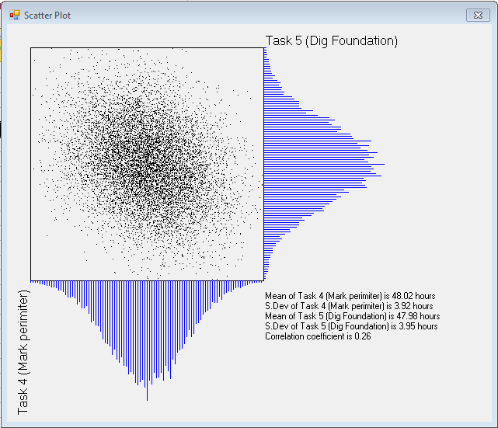
Correlation – Scatter Plot

Slide 9
Schedule Quality Check
DCMA 14pt Assessment
Analyze your project for compliance with all 14 of the DCMA schedule metric guidelines
Industry Best Practice
More than 10 additional metrics compared to the DCMA schedule assessment
User Configurable Selection and Criteria
Modify exclusions and thresholds

Slide 10
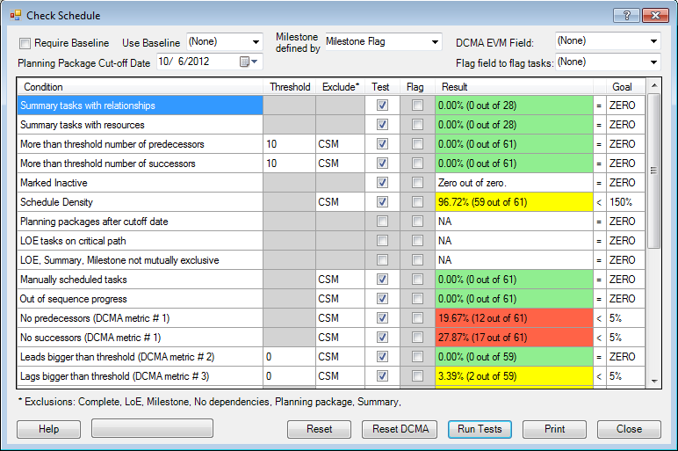
Schedule Quality Check

Slide 11
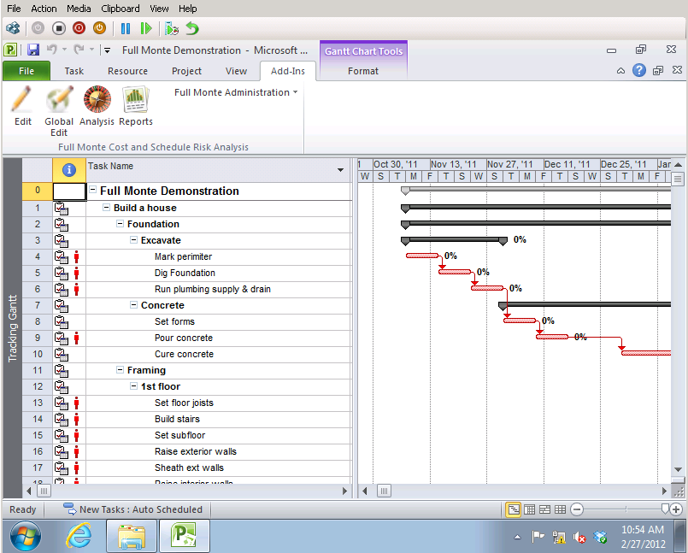
Integrated into Microsoft Project 2010

Slide 12
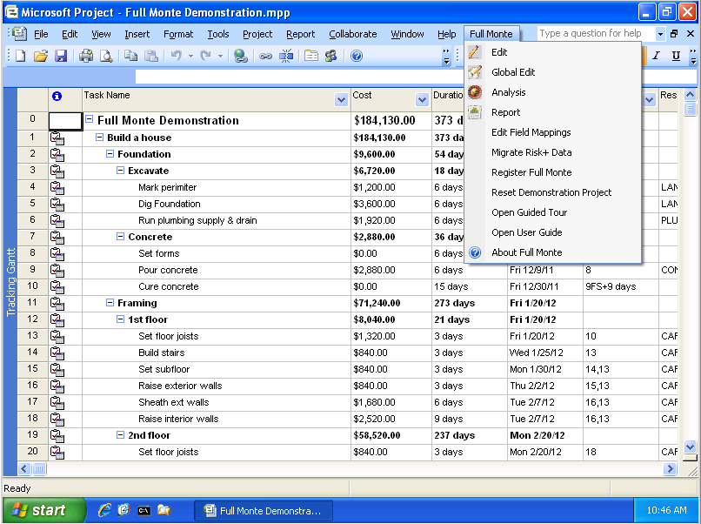
Integrated into Microsoft Project 2007

Slide 13
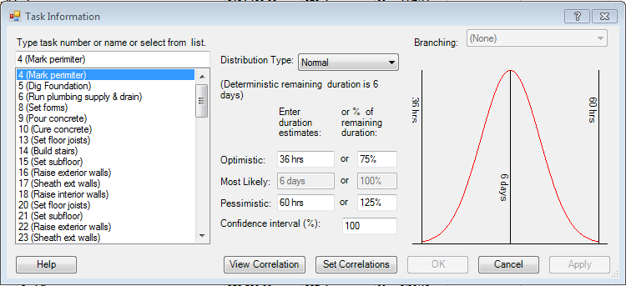
Sophisticated Data Editing
Integrated Navigation
Enter Optimistic and Pessimistic values as Durations or Percentages

Slide 14
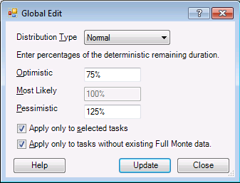
Global Edits
Control what gets updated

Slide 15
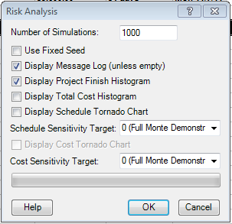
Comprehensive Analysis Options
Choose either Project Completion or Specific Milestones for Sensitivity Analysis

Slide 16
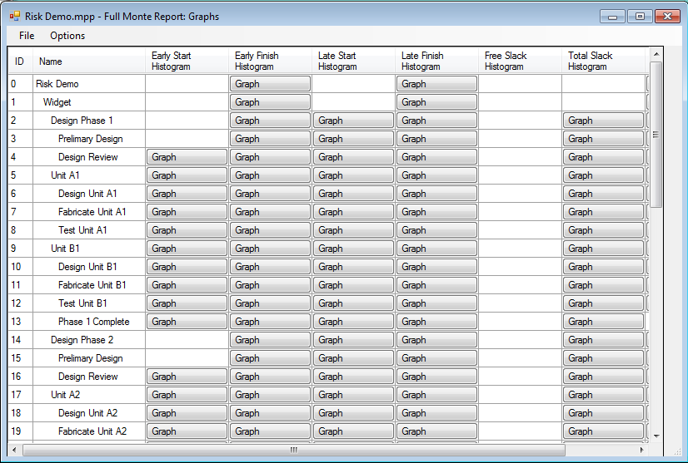
Easily find available Graphical Reports

Slide 17
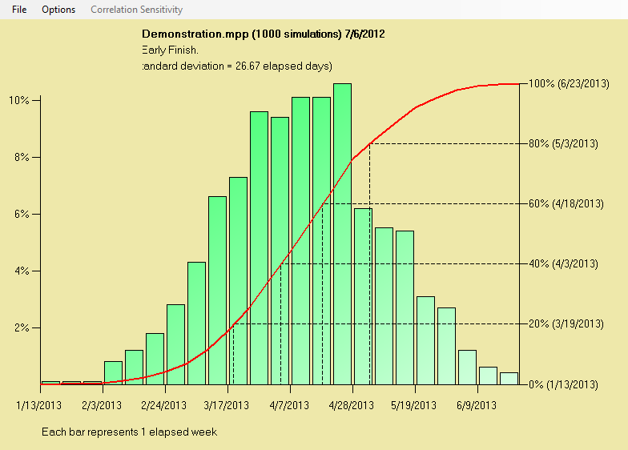
Histogram Reports

Slide 18
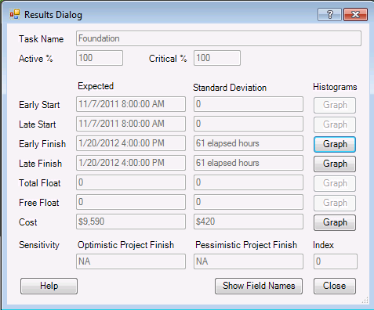
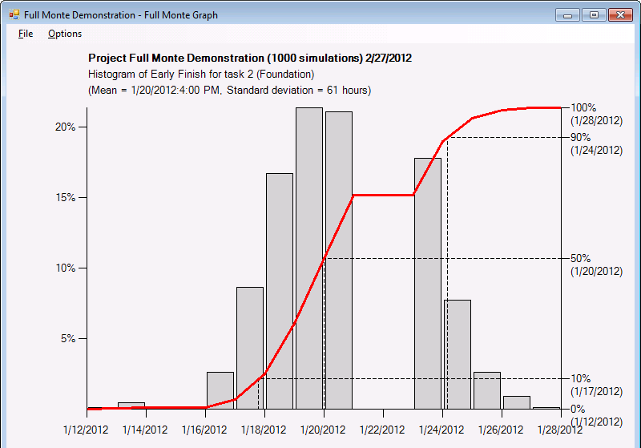
Intuitive navigation to relevant information
Detail Task Results
With immediate access
to appropriate graphs

Slide 19
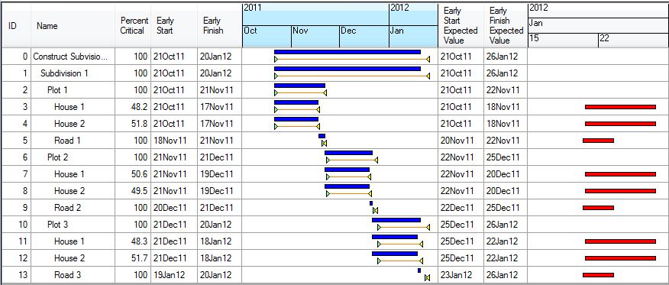
Gantt Charts
Combined Deterministic, Expected and Sensitivity

Slide 20
Compatible with Deltek Risk+ Data
Full Monte can convert and utilize existing Deltek Risk+ information including duration estimates and distribution types.
Full Monte features customizable mapping to Microsoft Project fields to enable co-existence with existing add-on/customer use of user fields.

Slide 21
Fast…
1000 Simulations on 3600 tasks in around 30 seconds

